Slide 1
FINAL PROJECT BIG DATA ANALYTICS VIRTUAL INTERNSHIP
Samuel Benny Dito

Slide 2


BACKGROUND
Big data is a set of data that has a very large volume or size consisting of structured, semi-structured, and unstructured data that can develop over time. The characteristics of big data are called the three v, namely volume, velocity, and variety.
As Big Data Analytics, Kimia Farma has the task of making reports and dashboards related to sales data for six months, starting from January to June 2022. Begin from the data warehouse stage, scheduling to analysis and visualization of several existing databases. Wherein the database is data related to sales, customers, and goods.

Slide 3
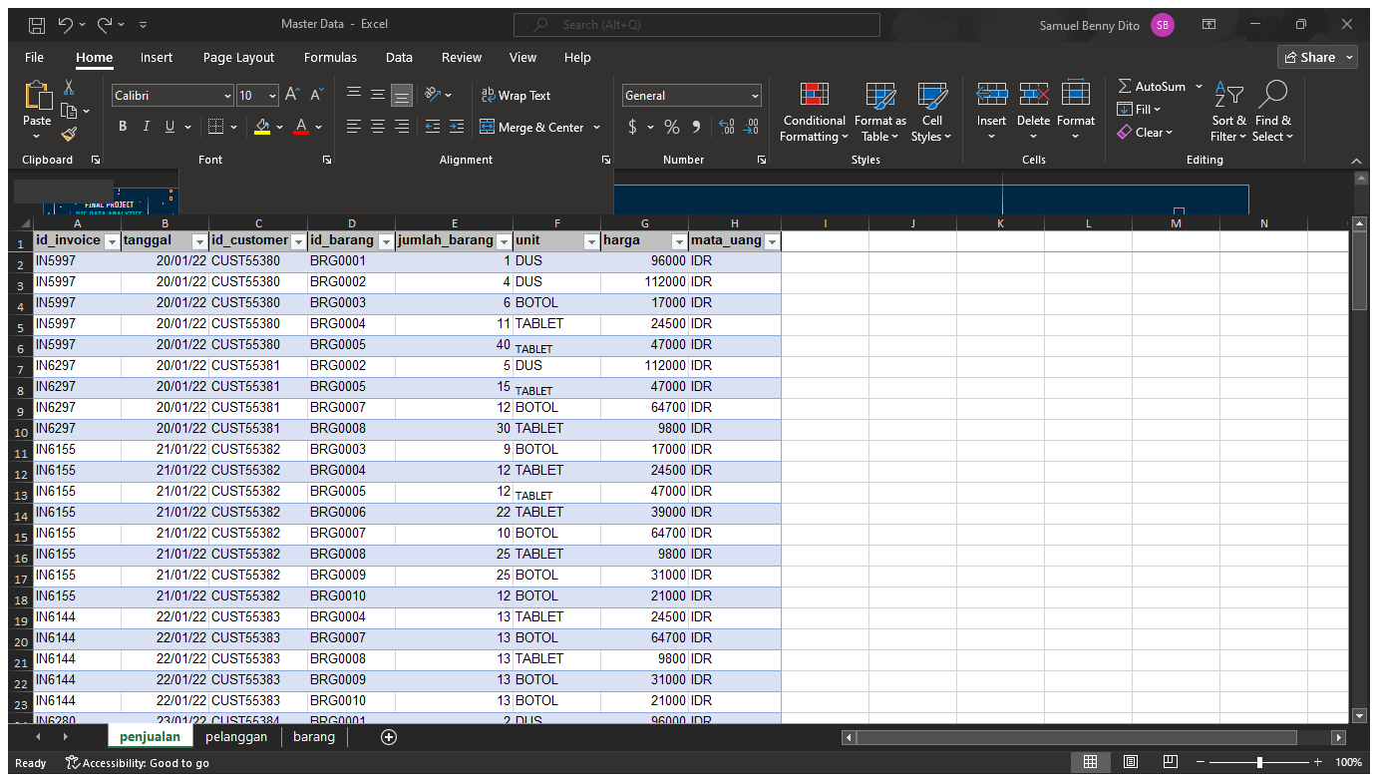
DATA PREPARATION & CLEANING
In the first stage, the data to be used are sales, customer and goods data. Next enters the stage of data cleansing. At this stage, what I did was delete unused columns, unify unit formats, tidy up the data, highlight data based on certain criteria, make ranges into tables, separate month by date and remove duplicate data using excel. It aims to prevent garbage in garbage out (GIGO)

Slide 4
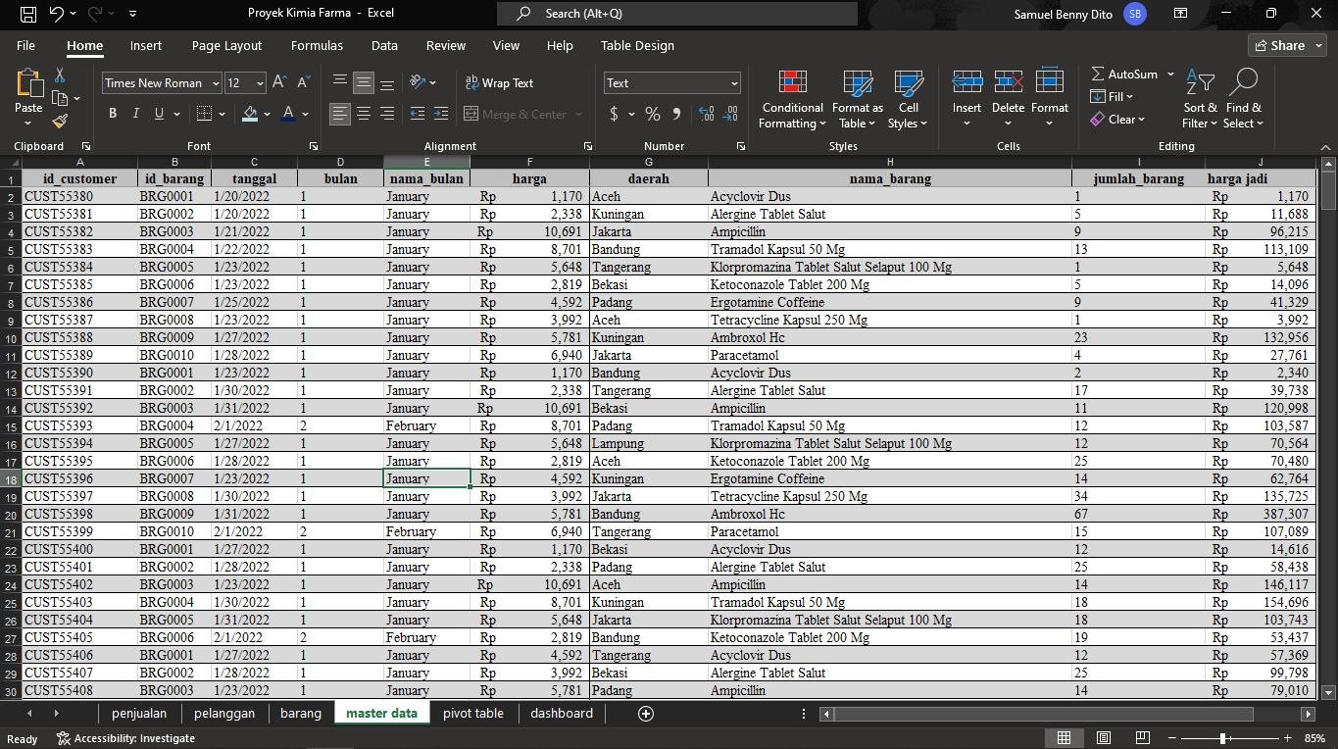
DATA PROCESING & VISUALIZATION
In the second stage is to create master data. Master data is a collection / withdrawal of data that will be used for the next stage, namely creating a pivot table. The withdrawal uses several formulas, one of which is VLOOKUP.

Slide 5
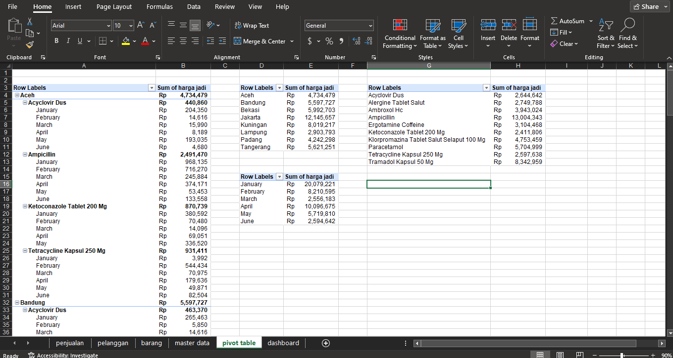
DATA PROCESING & VISUALIZATION
After the data is presented in one complete table. The next step is to create a pivot table based on several indicators, for further visualization. These indicators include total sales by region, total sales by product and sales trend by month. The indicator was chosen because it is an important variable in seeing the sales price.

Slide 6
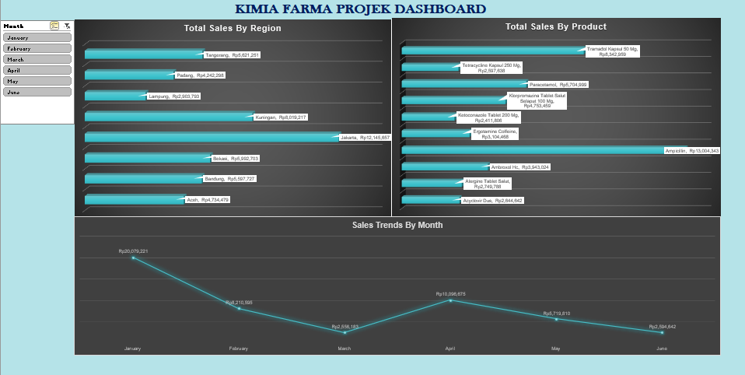
DATA PROCESING & VISUALIZATION
Dashboard is a collection of visualizations based on several indicators derived from pivot tables with the aim of finding important information in making business decisions. On this dashboard, it is equipped with a slicer in the form of a month to be able to see more details of the indicator in each month.

Slide 7
DATA PROCESING & VISUALIZATION
In the visualization of total sales by region, there is information that Jakarta is the area with the highest sales. Meanwhile, Lampung is the area with the lowest sales. Why does this happen? Even though the distance between Jakarta and Lampung is not so far compared to Jakarta Aceh. Aceh has better sales figures than Lampung. Whether pharma chemistry is not well known by the people of Lampung or the people of Lampung who close themselves hope that chemical pharma is because of one or two things. A special marketing strategy is needed for the Lampung area to have a stable sales figure above 4 million.

Slide 8
DATA PROCESING & VISUALIZATION
In the visualization of total sales by product, there is information that there is a considerable difference in sales prices between one item and another. This condition may occur because the social conditions of each region are different (this analysis can be taken more deeply if you add regional variables). But in general, the average sales have been in a fairly good range for the last 6 months, which is more than 2 million.

Slide 9
DATA PROCESING & VISUALIZATION
In the sales trend by month visualization, it shows a negative trend until the end of the 6th month (June). Even the sales figures decreased by 10x. In April, sales figures began to show an increase. But it is undeniable that the sales trend continues to decline until June. Many factors cause it, more in-depth analysis and data variables are needed to make a decision.

Slide 10
THANK YOU

